Slide 1
Provincial Policies, Aboriginal Rights & Forest Management
Dr. M.A. (Peggy) Smith
Presented to National Aboriginal Forestry Association Meeting
Forest Stewardship & FPIC: Our Doorway to Prosperity
December 2-5, 2014, Saskatoon

Slide 3
New Brunswick (Wyatt)
Peace & Friendship treaties, 1700s—military alliances, no ceding of land
First Nations Forest Agreements (FNFAs), 1997-: renewed every 5 yrs, 2006-07—$ 2 ½ mil in royalties among 15 First Nations; from 2,000–47,500 m³
Paul, 1997—treaty right to harvest timber on Crown land; overturned by NB Court of Appeal; led to FNFAs
Marshall, 1999—treaty right to fish; licence allocations
Sappier/Gray, 2006—treaty right to harvest timber for domestic use; firewood allocations now included in FNFAs
Duty to consult policy—lacks detail on processes & application

Slide 4
Quebec
James Bay & Northern Quebec Agreement, 1975 & Paix des Braves, 2002—revenue sharing, joint management
Aboriginal title lands—Comprehensive Claims Policy
Secretariat for Aboriginal Affairs—part of Exec Council
Interim Guide for Consulting Aboriginal Communities, 2006 & 2008—no joint development
Aboriginal Initiatives Fund II, 2013 for social, economic & community dev, incl consultation
Sustainable Development Act, 2013—section on Aboriginal consultation; QC resumes forest mgmt planning; consultation through local integrated land & resource management panels
Plan Nord—infrastructure development to access resources, esp. minerals; $100 million to train Aboriginal population

Slide 5
Ontario (Smith)
Historic treaties—Crown interprets as ceding lands resources
Crown Forest Sustainability Act, 1994—s. 23, joint forest management
Tenure reform—Local Forest Management Corps (2), Enhanced Sustainable Forest Licences—”provide local First Nations & communities a greater say in management of local forests”—more FNs holding eSFLs
Regulations—Forest Management Planning Manual—addresses consultation, representation on planning team, protection of Aboriginal values
Term & Condition 34—share of economic benefits
Mikisew 2005 & Grassy Narrows 2014—duty to consult
Mining Act, 2009—Aboriginal & treaty rights addressed
Far North Act, 2010—community-based land use planning (Whitefeather)

Slide 6
Manitoba (Anderson)
Historic treaties & Treaty Land Entitlement Framework Agreement (1997)→1 mil hectares, 15 First Nations
Manitoba Forest Act, 1987—no mention of Aboriginal peoples
Manitoba Conservation Guidelines for Implementation of Manitoba’s Provincial Policy for Crown Consultations with Aboriginal Peoples (2009)—specific guidance to individual ministries; Consultation Participation Fund, a commitment of $5 mil over 5 years, to be managed centrally within government
Aboriginal Consultation Unit, Dept. of Aboriginal & Northern Affairs
Work Permits Policy (2011)—require consultation

Slide 7
Saskatchewan (Gillis)
Historic treaties
Natural Resources Transfer Agreement, 1930—transfer of land ownership from federal to provincial Crown
SK Environmental Code, 2014 (Forest Resources Mgmt Act & Environmental Mgmt & Protection Act, 2010)—chapter on forest mgmt planning includes Aboriginal consultation based on respect for Aboriginal & treaty rights; requires strategy for sharing information with First Nations & Métis communities “whose ability to exercise Treaty or Aboriginal rights & carry out traditional uses is potentially adversely impacted” & schedule of public & First Nations & Métis community information sessions during period of forest mgmt planning
First Nations & Metis Consultation Policy Framework, 2010

Slide 8
Alberta (Cardinal, Laidlaw, Ross)
Historic treaties, Mikisew 2005
Forests Act, 2000—no mention of Aboriginal peoples
AB Env & Sustainable Resource Dev (ESRD): “Alberta owns all timber located on provincial Public lands”
Alberta Land Stewardship Act, SA 2009—regional planning; no consultation
Government of AB’s Policy on Consultation with First Nations on Land & Natural Resource Mgmt, 2013 & Guidelines on Consultation with First Nations on Land & Natural Resource Mgmt, July 2014—mainly operational (roads, plans, burns, herbicides), but also Forest Management Agreements & quotas
Aboriginal Consultation Office
Aboriginal Consultation Levy Act, 2013
First Nations: misunderstanding of Treaties; rigid view of consultation with short deadlines & lack of mechanism, aside from litigation, to influence government’s assessment of adequacy of consultation or accommodation

Slide 9
British Columbia (Lyall, Perreault)
Douglas historic treaties, Treaty 8
Aboriginal title lands—BC Treaty Commission 1992-
Tenure: Forest Resource Agreements, Forest Tenure Opportunities Agreements (FTOA)—short term, not replaceable, jobs; replaced by Forest Consultation & Revenue Sharing Agreements (over 100 signed, but many not implemented)—subject to wood supply; revenue sharing 3% of stumpage; First Nations have no say in formula—duty to consult fulfilled?
First Nations Woodland Licences—larger area, 25-99 yrs—only 2; subject to having FTOA, wood supply, Ministerial approval
Constrained by Forest & Range Practices Act, 2004 & Forest Act—no guidance on protection of cultural values except for CMT
Tsilhqot’in: BC should come up with a new definition of sustainability in its planning to consider Aboriginal rights

Slide 10
Conclusions & Common Themes
All about access to resources—opening new areas of mineral, forest & energy potential, esp. North
Tenure—an increasing # to First Nations, but no guarantee of economic improvement; limited economic participation, but failure to understand &/or adequately address Aboriginal values & rights—lack of negotiations for shared understanding
Provincial policies have not kept up with SCC decisions– failure to implement & limited interpretation of SCC decisions, especially duty to consult—unilateral, operational, but not strategic
Strategic—programs & policies, revenue sharing, licensing, allowable cut
Limited funding available for consultation; controlled by provinces; ghettoizing consultation by setting up separate consultation offices?
Limited # of negotiated framework agreements
Free, prior & informed consent not on provincial agendas

Slide 11
International & National Perspectives on Aboriginal Rights & Forest Management
Brad Young
Presented to National Aboriginal Forestry Association Meeting
Forest Stewardship & FPIC: Our Doorway to Prosperity
December 2-5, 2014, Saskatoon

Slide 12
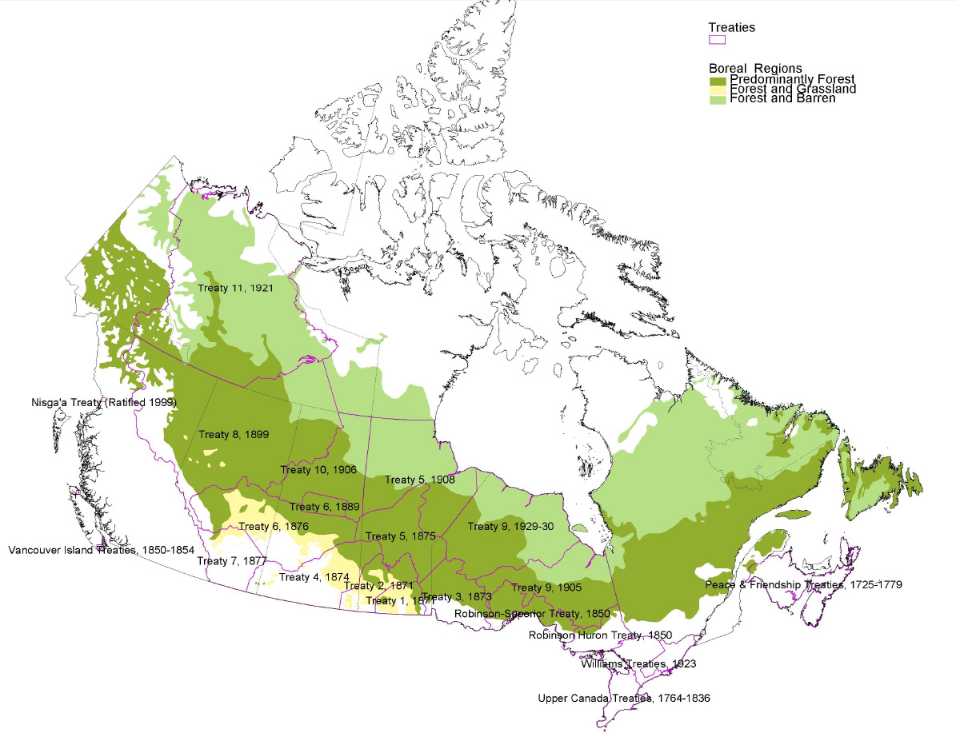
Tenure growing across Canada
Notes:
FN’s are primarily in the forest (the boreal)

Slide 13
Before 1983 - <100,000m3
2003 - 8,053,570 m3
2006 - 11,655,474 m3
2014 - 27,269,285 m3

Slide 14
Tenure growing across Canada
 | 2003 | 2006 | 2013
British Columbia | 3,716,232 | 6,006,805 | 16,882,323
Alberta | 975,941 | 1,145,963 | Not available
Saskatchewan | 1,143,690 | 1,971,690 | 6,239,960
Manitoba | 132,605 | 153,887 | 362,150
Ontario | 1,199,341 | 1,281,380 | 2,661,000
Quebec | 652,381 | 858,652 | 858,652
Nova Scotia | 0 | 0 | 0
New Brunswick | 233,380 | 237,097 | 265,200
Newfoundland & Labrador | 0 | 0 | 0
 | 8,053,570 | 11,655,474 | 27,269,285

Slide 15
